Slide 1
ROBO-ADVISOR INTERFACE
8 March 2018 Draft

Slide 2
Overview
Stage 1 | 1. User orientation
Stage 2 | 2.1: Showcase demo
 | 2.2: Manipulation check
Stage 3 | 3.1: Main experiment
 | 3.2: Final evaluation

Slide 3
 | Chief tasks | Deliverables & DDL
Week 1 Mar 5-11 | First draft of mock-up (Wanlu) Initiate IRB preparation (Yihan) Design script styles (Yihan) | Mock up: Mar 8; IRB basic info: Mar 9; Key points on script styles: Mar 8;
Week 2 Mar 12-18 | Develop the basic functional components (Wanlu) Draft scripts for orientation & main experiments (Cuimin) Fill in IRB form (Yihan) Look for graphic designer (Yihan) | A functional surface product: Mar 15; First draft of scripts: Mar 16; First draft of IRB: Mar 15; 1-2 candidates of designer: Mar 15;
Week 3 Mar 19-25 | Integrate the front-end and back-end components (Wanlu) Design script logic flow + IRB revision (Yihan) Revise scripts (Cuimin) Start UI design (TBA) | A semi-functional product: Mar 22; Revised scripts; Revised IRB application; Mock-up of UI design;
Week 4 Mar 26 – Apr 1 | Integrate scripts into the product and make it ready for user test (Wanlu) Submit IRB Revise the front-end according to UI design (TBA) | A fully functional product: Mar 29; IRB submission
Week 5 Apr 2 -8 | User test (Yihan + Cuimin) Debugging & iteration according to user test | Invite at least 5 users and summarize the results: Apr 6;

Slide 4
Orientation - attributes
Attributes of robo-advisor:
Name (Elite vs. grass-root: Warren vs. Tom)
Gender (male, female, neutral)
Profile picture (with different dress code: consultant vs. butler)
Conversational style (controlling vs. submissive)
Performance(high, medium, low)

Slide 5
Orientation - greetings
Greetings:
Robo: Hi, my name is Tom and I help people manage their portfolio. How are you doing today?
User: I’m feeling good [for wanlu: two options]
Robo: May I get to know a little more about you? (see example in the next page)
User: My name is ___(for wanlu, fill in the blanks), I’m ___ (for wanlu: gender options here). I’m ___ (marital status), and have ___children (number of children). My annual income is about ___(income range options), and my expectation for you is ___ (options of annualized return: 5%, 10%, 15%).
Robo: Thank you very much! Now I’ll work out a wealth management plan for you
User: I’m ready to proceed

Slide 7
Manipulation check
Now you have worked with your robo-advisor _robo.name_ for a while, how do you think of its performance so far? Please use the following slider to indicate your answer (0 = poor, 10 = excellent).
Poor ~ Average
Average~Good
Good~Excellent
0
10

Slide 8
Overall check
1. You have worked with your robo-advisor _robo.name_ for another round, now do you think of its performance differently? Please update us with your current opinion using the following slider to indicate your answer (0 = poor, 10 = excellent).
2. If we were to officially launch the robo-advisor _robo.name_, would you like to use it for wealth management? (0 = not likely, 10 = very likely)
Poor ~ Average
Average~Good
Good~Excellent
0
10
Negative
Positive
0
10

Slide 9
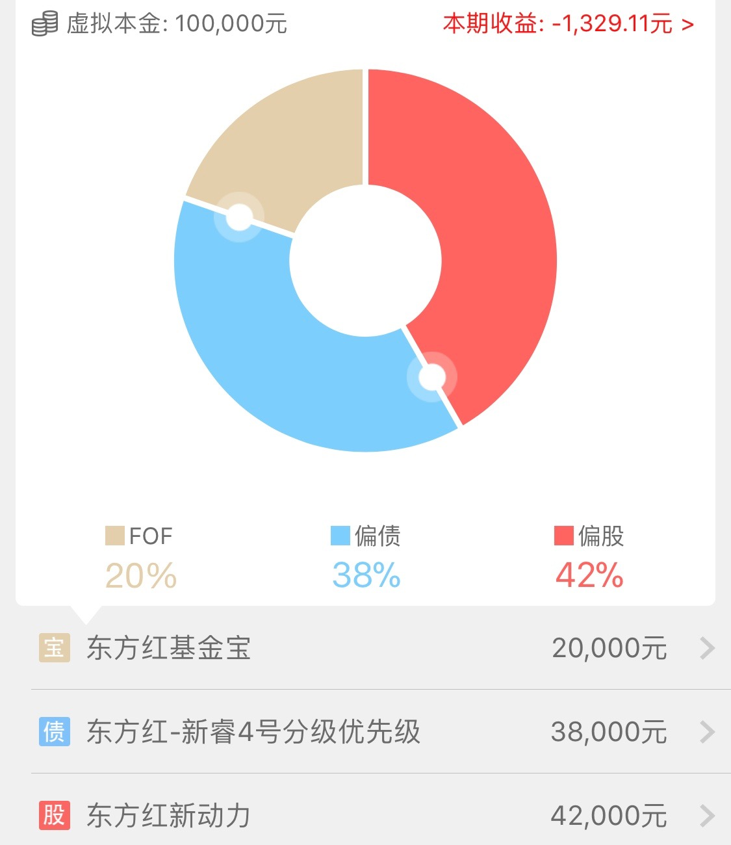
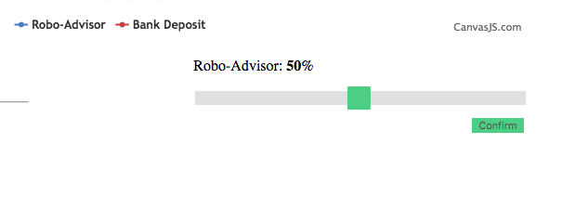
Slider to Pie
Current version:
Optimized version:

